Slide 1
Chapter 3 – Agile Software Development
CS 425 September 19, 2024
Ian Sommerville,
Software Engineering, 10th Edition
Pearson Education, Addison-Wesley
Note: These are a slightly modified version of Chapter 3 slides available from the author’s site http://iansommerville.com/software-engineering-book/
Chapter 3 Agile Software Development

Slide 2
Topics covered
Agile methods
Agile development techniques
Agile project management
Scaling agile methods
Chapter 3 Agile Software Development

Slide 3
Rapid software development
Rapid development and delivery is now often the most important requirement for software systems
Businesses operate in a fast changing environment and it is practically impossible to produce a set of stable software requirements
Software has to evolve quickly to reflect changing business needs
Plan-driven development is essential for some types of system but does not meet these business needs
Agile development methods emerged in the late 1990s; their aim was to radically reduce the delivery time for working software systems
Chapter 3 Agile Software Development
Notes:
Some businesses may be willing to trade off software quality and compromise on requirements if they can deploy essential new software quickly.

Slide 4
Agile development
Program specification, design and implementation are inter-leaved
The system is developed as a series of versions or increments with stakeholders involved in version specification and evaluation
Frequent delivery of new versions for evaluation
Extensive tool support (e.g. automated testing tools) used to support development
Minimal documentation – focus on working code
Chapter 3 Agile Software Development

Slide 5
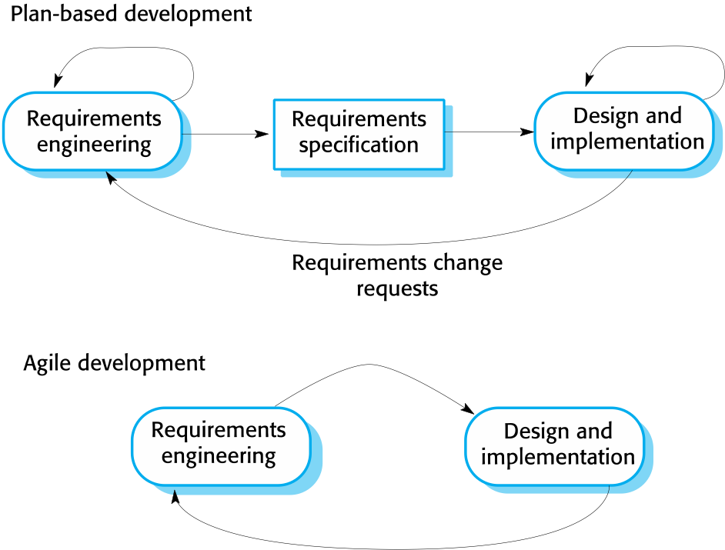
Plan-driven and agile development
Chapter 3 Agile Software Development

Slide 6
Plan-driven and agile development
Plan-driven development
A plan-driven approach to software engineering is based around separate development stages with the outputs to be produced at each of these stages planned in advance
Not necessarily waterfall model – plan-driven, incremental development is also possible
Iteration occurs within activities
Agile development
Specification, design, implementation and testing are inter-leaved and the outputs from the development process are decided through a process of negotiation during the software development process
Chapter 3 Agile Software Development
Notes:
Agile approaches to software development considerer design and implementation to be the central activities in the software process

Slide 7
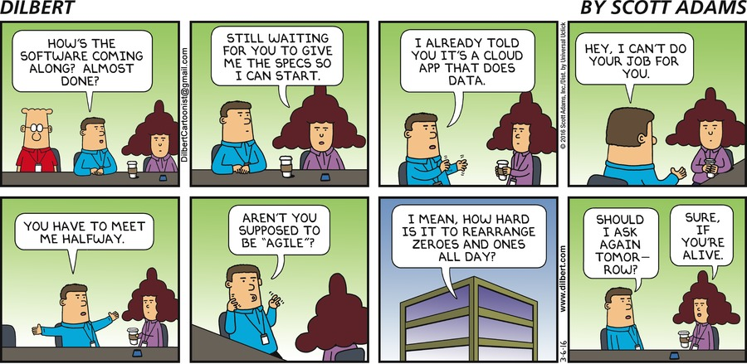
Agile methods
Chapter 3 Agile Software Development

Slide 8
Agile methods
Dissatisfaction with the overheads involved in software design methods of the 1980s and 1990s led to the creation of agile methods. These methods:
Focus on the code rather than the design
Are based on an iterative approach to software development
Are intended to deliver working software quickly and evolve this rapidly to meet changing requirements
The aim of agile methods is to reduce overheads in the software process (e.g., by limiting documentation) and to be able to respond quickly to changing requirements without excessive rework
Chapter 3 Agile Software Development
Notes:
Agile sprints are for a short period of time allowing for frequent releases and changing of direction quickly with little impact to the development velocity of the team

Slide 9
The Agile Manifesto
We are uncovering better ways of developing software by doing it and helping others do it. Through this work we have come to value:
Individuals and interactions over processes and tools
Working software over comprehensive documentation
Customer collaboration over contract negotiation
Responding to change over following a plan
That is, while there is value in the items on the right, we value the items on the left more
Chapter 3 Agile Software Development

Slide 10
The principles of agile methods
Principle | Description
Customer involvement | Customers should be closely involved throughout the development process. Their role is provide and prioritize new system requirements and to evaluate the iterations of the system.
Incremental delivery | The software is developed in increments with the customer specifying the requirements to be included in each increment.
People not process | The skills of the development team should be recognized and exploited. Team members should be left to develop their own ways of working without prescriptive processes.
Embrace change | Expect the system requirements to change and so design the system to accommodate these changes.
Maintain simplicity | Focus on simplicity in both the software being developed and in the development process. Wherever possible, actively work to eliminate complexity from the system.
Chapter 3 Agile Software Development

Slide 11
Agile method applicability
Product development where a software company is developing a small or medium-sized product for sale
Virtually all software products and apps are now developed using an agile approach
Custom system development within an organization, where there is a clear commitment from the customer to become involved in the development process and where there are few external rules and regulations that affect the software
Chapter 3 Agile Software Development

Slide 12
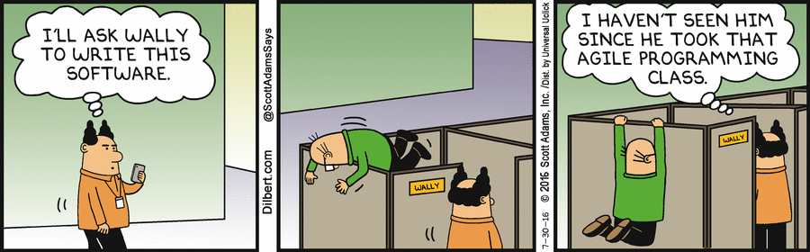
Agile development techniques
Chapter 3 Agile Software Development

Slide 13
Extreme programming
A very influential agile method, developed in the late 1990s, that introduced a range of agile development techniques.
Extreme Programming (XP) takes an ‘extreme’ approach to iterative development.
New versions may be built several times per day
Increments are delivered to customers every 2 weeks
All tests must be run for every build and the build is only accepted if tests run successfully
Chapter 3 Agile Software Development

Slide 14
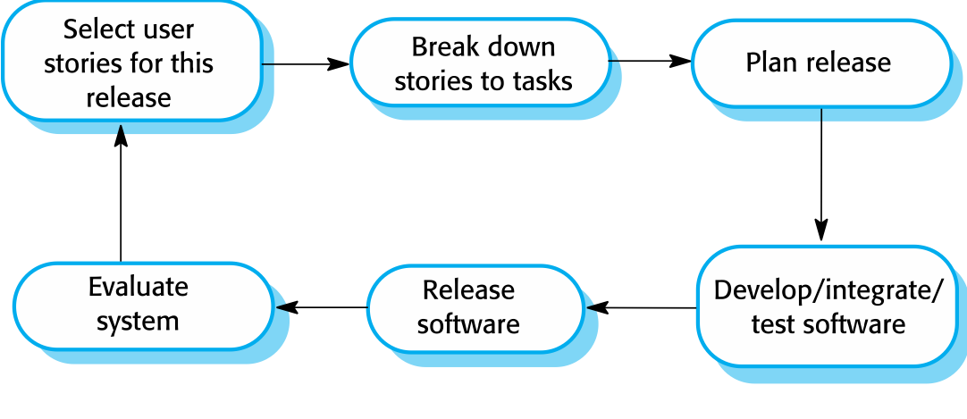
The extreme programming release cycle
Chapter 3 Agile Software Development

Slide 15
Extreme programming practices (a)
Principle or practice | Description
Incremental planning | Requirements are recorded on story cards and the stories to be included in a release are determined by the time available and their relative priority. The developers break these stories into development ‘Tasks’. See Figures 3.5 and 3.6.
Small releases | The minimal useful set of functionality that provides business value is developed first. Releases of the system are frequent and incrementally add functionality to the first release.
Simple design | Enough design is carried out to meet the current requirements and no more.
Test-first development | An automated unit test framework is used to write tests for a new piece of functionality before that functionality itself is implemented.
Refactoring | All developers are expected to refactor the code continuously as soon as possible code improvements are found. This keeps the code simple and maintainable.
Chapter 3 Agile Software Development

Slide 16
Extreme programming practices (b)
Pair programming | Developers work in pairs, checking each other’s work and providing the support to always do a good job.
Collective ownership | The pairs of developers work on all areas of the system, so that no islands of expertise develop and all the developers take responsibility for all of the code. Anyone can change anything.
Continuous integration | As soon as the work on a task is complete, it is integrated into the whole system. After any such integration, all the unit tests in the system must pass.
Sustainable pace | Large amounts of overtime are not considered acceptable as the net effect is often to reduce code quality and medium term productivity
On-site customer | A representative of the end-user of the system (the customer) should be available full time for the use of the XP team. In an extreme programming process, the customer is a member of the development team and is responsible for bringing system requirements to the team for implementation.
Chapter 3 Agile Software Development

Slide 17
XP and agile principles
Incremental development is supported through small, frequent system releases
Customer involvement means full-time customer engagement with the team
People not process through pair programming, collective ownership and a process that avoids long working hours
Change supported through regular system releases
Maintaining simplicity through constant refactoring of code
Chapter 3 Agile Software Development

Slide 18
Influential XP practices
Extreme programming has a technical focus and is not easy to integrate with management practice in most organizations
Consequently, while agile development uses practices from XP, the method as originally defined is not widely used
Key practices
User stories for specification
Refactoring
Test-first development
Pair programming
Chapter 3 Agile Software Development

Slide 19
Upcoming Workshops
Github Workshop 9/26 (Thursday) 6 PM - 7 PM in WPEB 100 with Zach Estreito
Only 58 seats; please register
https://www.signupgenius.com/go/10C0A4EACA82CAAF4C43-51663863-github#/
Database Workshop 10/3 (next Thursday) 10 AM - 11 AM in WPEB 100 with Erin Keith
Only 58 seats; please register
https://www.signupgenius.com/go/10C0A4EACA82CAAF4C43-51664633-database#/
Working on scheduling an ML and Educational app/website workshop…

Slide 20
User stories for requirements
In XP, a customer or user is part of the XP team and is responsible for making decisions on requirements
User requirements are expressed as user stories or scenarios
These are written on cards and the development team break them down into implementation tasks. These tasks are the basis of schedule and cost estimates.
The customer chooses the stories for inclusion in the next release based on their priorities and the schedule estimates
Chapter 3 Agile Software Development

Slide 21
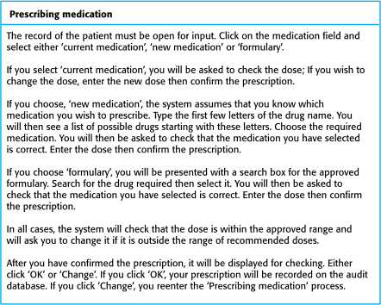
A ‘prescribing medication’ story
Chapter 3 Agile Software Development

Slide 22
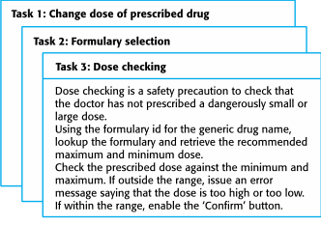
Examples of task cards for prescribing medication
Chapter 3 Agile Software Development

Slide 23
Sample User Story
As a <type of user>, I want <to perform some task> so that I can <achieve some goal/benefit/value>.
As a Amazon Customer,
I want to be able to search for a product
So that I can purchase the product I need.
Chapter 3 Agile Software Development
Notes:
This is not in the book

Slide 24
Structure of Stories and Tasks
Epic
Software Product
Story
User Stories
Story
Development
Plan
Task
Task
Task
Task
Task
Chapter 3 Agile Software Development

Slide 25
Structure of Stories and Tasks
Tic Tac Toe Score Board
Software Product
As a player,
I want to be able to track my score, so I can see if my score is improving
As a player, I want to be able to see my friends scores, so we can determine who has the best score
User Stories
Display scores to current player
Create a database of all player scores
Rank and display all user scores
Record Player Score
Assign Score to User
Development
Plan (Tasks)
Chapter 3 Agile Software Development

Slide 26
Refactoring
Conventional wisdom in software engineering is to design for change. It is worth spending time and effort anticipating changes as this reduces costs later in the life cycle.
XP, however, maintains that this is not worthwhile as changes cannot be reliably anticipated
Rather, it proposes constant code improvement (refactoring) to make changes easier when they have to be implemented
Chapter 3 Agile Software Development

Slide 27
Refactoring
Programming team look for possible software improvements and make these improvements even where there is no immediate need for them
This improves the understandability of the software and so reduces the need for documentation
Changes are easier to make because the code is well-structured and clear
However, some changes require architecture refactoring and this is much more expensive
Chapter 3 Agile Software Development
Notes:
May cause delays in development extending schedules – non essential features

Slide 28
Examples of refactoring
Re-organization of a class hierarchy to remove duplicate code
Tidying up and renaming attributes and methods to make them easier to understand
The replacement of inline code with calls to methods that have been included in a program library
Chapter 3 Agile Software Development

Slide 29
Test-first development
Testing is central to XP, where the program is tested after every change has been made
XP testing features:
Test-first development
Incremental test development from scenarios
User involvement in test development and validation
Automated test harnesses are used to run all component tests each time that a new release is built
Chapter 3 Agile Software Development

Slide 30
Test-driven development
Writing tests before code clarifies the requirements to be implemented
Tests are written as programs rather than data so that they can be executed automatically. The test includes a check that it has executed correctly.
All previous and new tests are run automatically when new functionality is added, thus checking that the new functionality has not introduced errors
Chapter 3 Agile Software Development

Slide 31
Customer involvement
The role of the customer in the testing process is to help develop acceptance tests for the stories that are to be implemented in the next release of the system
The customer who is part of the team writes tests as development proceeds. All new code is therefore validated to ensure that it is what the customer needs.
However, people adopting the customer role have limited time available and so cannot work full-time with the development team. They may feel that providing the requirements was enough of a contribution and so may be reluctant to get involved in the testing process.
Chapter 3 Agile Software Development

Slide 32
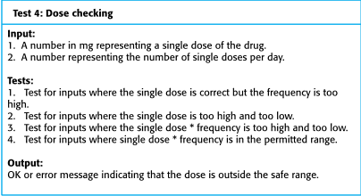
Test case description for dose checking
Chapter 3 Agile Software Development

Slide 33
Test automation
Test automation means that tests are written as executable components before the task is implemented
These testing components should be stand-alone, should simulate the submission of input to be tested and should check that the result meets the output specification. An automated test framework is a system that makes it easy to write executable tests and submit a set of tests for execution.
As testing is automated, there is always a set of tests that can be quickly and easily executed
Whenever any functionality is added to the system, the tests can be run and problems that the new code has introduced can be caught immediately
Chapter 3 Agile Software Development
Notes:
Smoke Testing, Automated Tests, Test Scripts , unit tests

Slide 34
Problems with test-first development
Programmers prefer programming to testing and sometimes they take short cuts when writing tests. For example, they may write incomplete tests that do not check for all possible exceptions that may occur.
Some tests can be difficult to write incrementally. For example, in a complex user interface, it is often difficult to write unit tests for the code that implements the ‘display logic’ and workflow between screens.
It difficult to judge the completeness of a set of tests. Although you may have a lot of system tests, your test set may not provide complete coverage.
Chapter 3 Agile Software Development

Slide 35
Pair programming
Pair programming involves programmers working in pairs, developing code together
This helps develop common ownership of code and spreads knowledge across the team
It serves as an informal review process as each line of code is looked at by more than one person
It encourages refactoring as the whole team can benefit from improving the system code
Chapter 3 Agile Software Development

Slide 36
Pair programming
In pair programming, programmers sit together at the same computer to develop the software
Pairs are created dynamically so that all team members work with each other during the development process
The sharing of knowledge that happens during pair programming is very important as it reduces the overall risks to a project when team members leave
Pair programming is not necessarily inefficient and there is some evidence that suggests that a pair working together is more efficient than 2 programmers working separately
Chapter 3 Agile Software Development

Slide 37
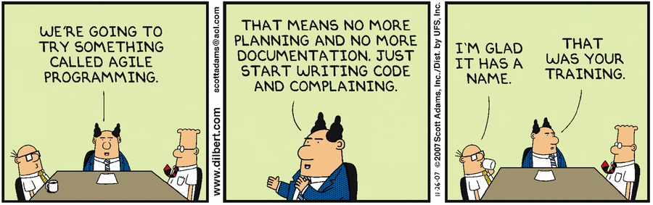
Agile project management
Chapter 3 Agile Software Development

Slide 38
Agile project management
The principal responsibility of software project managers is to manage the project so that the software is delivered on time and within the planned budget for the project
The standard approach to project management is plan-driven. Managers draw up a plan for the project showing what should be delivered, when it should be delivered and who will work on the development of the project deliverables.
Agile project management requires a different approach, which is adapted to incremental development and the practices used in agile methods
Chapter 3 Agile Software Development

Slide 39
Agile Vs Scrum
Agile is a methodology based on iterative development
Scrum is a type of agile approach that is used in software development
For your Resume:
Familiar with Agile methodologies and working in a Scrum development environment
Do Not Put:
Familiar with Scrum methodologies
30/10/2014
Chapter 3 Agile Software Development

Slide 40
Scrum
Scrum is an agile method that focuses on managing iterative development rather than specific agile practices
There are three phases in Scrum:
The initial phase is an outline planning phase where you establish the general objectives for the project and design the software architecture.
This is followed by a series of sprint cycles, where each cycle develops an increment of the system
The project’s closure phase wraps up the project, completes required documentation such as system help frames and user manuals, and assesses the lessons learned from the project
Chapter 3 Agile Software Development

Slide 41
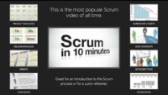
Intro to SCURM in Under 10 Minutes
https://www.youtube.com/watch?v=XU0llRltyFM
09/27/2022
Chapter 3 Agile Software Development
Notes:
https://www.youtube.com/watch?v=XU0llRltyFM

Slide 42
Scrum terminology (a)
Scrum term | Definition
Development team | A self-organizing group of software developers, which should be no more than 7 people. They are responsible for developing the software and other essential project documents.
Potentially shippable product increment | The software increment that is delivered from a sprint. The idea is that this should be ‘potentially shippable’ which means that it is in a finished state and no further work, such as testing, is needed to incorporate it into the final product. In practice, this is not always achievable.
Product backlog | This is a list of ‘to do’ items which the Scrum team must tackle. They may be feature definitions for the software, software requirements, user stories or descriptions of supplementary tasks that are needed, such as architecture definition or user documentation.
Product owner | An individual (or possibly a small group) whose job is to identify product features or requirements, prioritize these for development and continuously review the product backlog to ensure that the project continues to meet critical business needs. The Product Owner can be a customer but might also be a product manager in a software company or other stakeholder representative.
Chapter 3 Agile Software Development

Slide 43
Scrum terminology (b)
Scrum term | Definition
Scrum | A daily meeting of the Scrum team that reviews progress and prioritizes work to be done that day. Ideally, this should be a short face-to-face meeting that includes the whole team.
ScrumMaster | The ScrumMaster is responsible for ensuring that the Scrum process is followed and guides the team in the effective use of Scrum. He or she is responsible for interfacing with the rest of the company and for ensuring that the Scrum team is not diverted by outside interference. The Scrum developers are adamant that the ScrumMaster should not be thought of as a project manager. Others, however, may not always find it easy to see the difference.
Sprint | A development iteration. Sprints are usually 2-4 weeks long.
Velocity | An estimate of how much product backlog effort that a team can cover in a single sprint. Understanding a team’s velocity helps them estimate what can be covered in a sprint and provides a basis for measuring improving performance.
Chapter 3 Agile Software Development

Slide 44
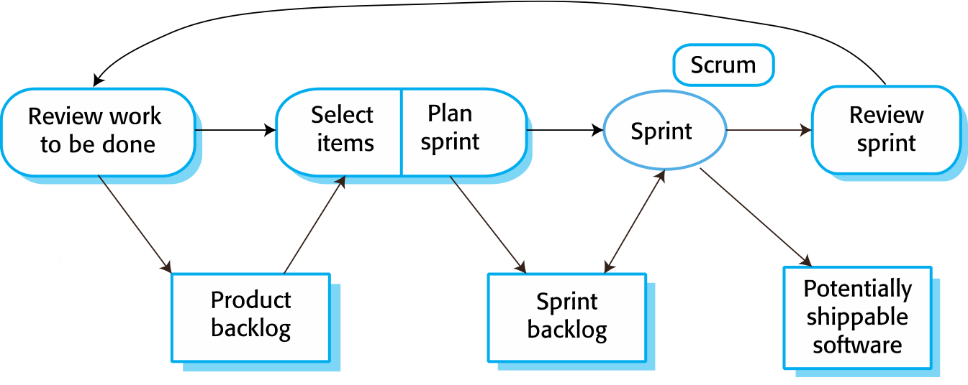
Scrum sprint cycle
Chapter 3 Agile Software Development

Slide 45
The Scrum sprint cycle
Sprints are fixed length, normally 2–4 weeks
The starting point for planning is the product backlog, which is the list of work to be done on the project
The selection phase involves all of the project team who work with the customer to select the features and functionality from the product backlog to be developed during the sprint
Chapter 3 Agile Software Development

Slide 46
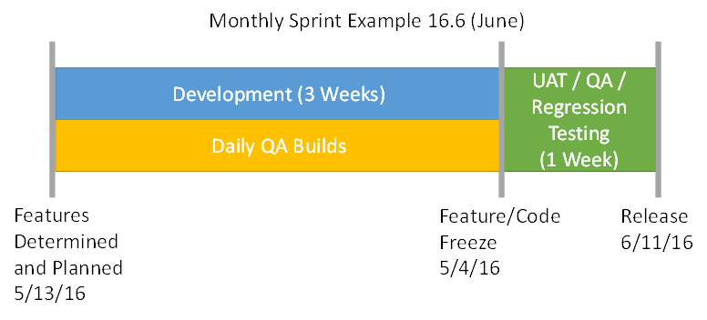
Examples of a SCRUM Sprint Cycle
Sprint 1
Sprint 2
Feature Planning (1 Week)
Features Determined and Planned 6/4/16
Feature/Code Freeze 6/25/16
Release 6/2/16
30/10/2014
Chapter 3 Agile Software Development

Slide 47
The Sprint cycle
Once these are agreed, the team organize themselves to develop the software
During this stage the team is isolated from the customer and the organization, with all communications channelled through the ‘Scrum master’
The role of the Scrum master is to protect the development team from external distractions
At the end of the sprint, the work done is reviewed and presented to stakeholders. The next sprint cycle then begins.
Chapter 3 Agile Software Development

Slide 48
Teamwork in Scrum
The Scrum master is a facilitator who arranges daily meetings, tracks the backlog of work to be done, records decisions, measures progress against the backlog and communicates with customers and management outside of the team
The whole team attends short daily meetings (Scrums) where all team members share information, describe their progress since the last meeting, problems that have arisen and what is planned for the following day.
This means that everyone on the team knows what is going on and, if problems arise, can re-plan short-term work to cope with them
Chapter 3 Agile Software Development

Slide 49
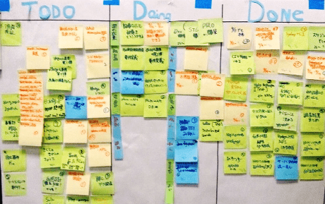
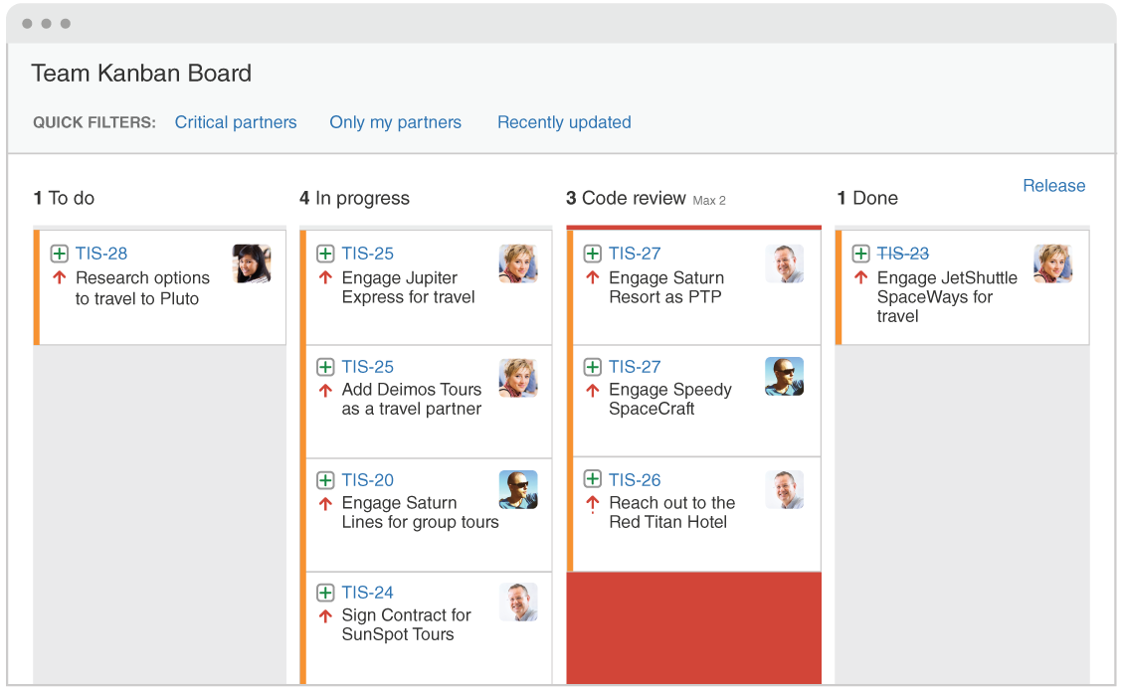
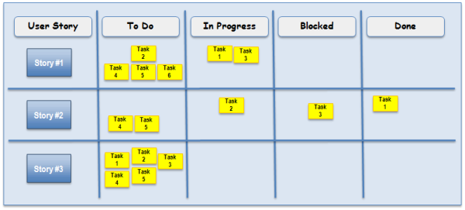
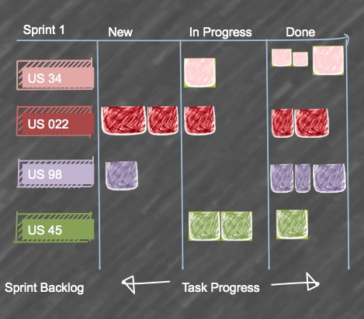
Scrum Tracking
30/10/2014
Chapter 3 Agile Software Development
Notes:
kanban board & Sprint Boards

Slide 50
Scrum benefits
The product is broken down into a set of manageable and understandable chunks
Unstable requirements do not hold up progress
The whole team have visibility of everything and consequently team communication is improved
Customers see on-time delivery of increments and gain feedback on how the product works
Trust between customers and developers is established and a positive culture is created in which everyone expects the project to succeed
Chapter 3 Agile Software Development

Slide 51
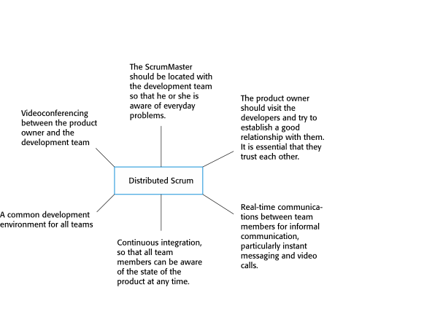
Distributed Scrum
Chapter 3 Agile Software Development
Notes:
Allows companies to take advantage of lower cost staff in other countries

Slide 52
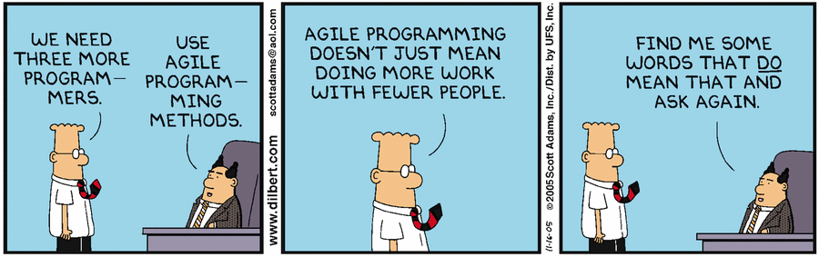
Scaling agile methods
Chapter 3 Agile Software Development

Slide 53
Scaling agile methods
Agile methods have proved to be successful for small and medium sized projects that can be developed by a small co-located team
It is sometimes argued that the success of these methods comes because of improved communications which is possible when everyone is working together
Scaling up agile methods involves changing these to cope with larger, longer projects where there are multiple development teams, perhaps working in different locations
Chapter 3 Agile Software Development

Slide 54
Scaling out and scaling up
‘Scaling up’ is concerned with using agile methods for developing large software systems that cannot be developed by a small team
‘Scaling out’ is concerned with how agile methods can be introduced across a large organization with many years of software development experience
When scaling agile methods it is important to maintain agile fundamentals:
Flexible planning, frequent system releases, continuous integration, test-driven development, and good team communications
Chapter 3 Agile Software Development

Slide 55
Practical problems with agile methods
The informality of agile development is incompatible with the legal approach to contract definition that is commonly used in large companies
Agile methods are most appropriate for new software development rather than software maintenance. Yet the majority of software costs in large companies come from maintaining their existing software systems
Agile methods are designed for small co-located teams yet much software development now involves worldwide distributed teams
Chapter 3 Agile Software Development

Slide 56
Contractual issues
Most software contracts for custom systems are based around a specification, which sets out what has to be implemented by the system developer for the system customer
However, this precludes interleaving specification and development as is the norm in agile development
A contract that pays for developer time rather than functionality is required
However, this is seen as a high risk by many legal departments because what has to be delivered cannot be guaranteed
Chapter 3 Agile Software Development
Notes:
Consulting

Slide 57
Agile methods and software maintenance
Most organizations spend more on maintaining existing software than they do on new software development. So, if agile methods are to be successful, they have to support maintenance as well as original development
Two key issues:
Are systems that are developed using an agile approach maintainable, given the emphasis in the development process of minimizing formal documentation?
Can agile methods be used effectively for evolving a system in response to customer change requests?
Problems may arise if original development team cannot be maintained
Chapter 3 Agile Software Development

Slide 58
Agile maintenance
Key problems are:
Lack of product documentation
Keeping customers involved in the development process
Maintaining the continuity of the development team
Agile development relies on the development team knowing and understanding what has to be done
For long-lifetime systems, this is a real problem as the original developers will not always work on the system
Chapter 3 Agile Software Development
Notes:
Tasks may not be defined well

Slide 59
Agile and plan-driven methods
Most projects include elements of plan-driven and agile processes. Deciding on the balance depends on:
Is it important to have a very detailed specification and design before moving to implementation? If so, you probably need to use a plan-driven approach.
Is an incremental delivery strategy, where you deliver the software to customers and get rapid feedback from them, realistic? If so, consider using agile methods.
How large is the system that is being developed? Agile methods are most effective when the system can be developed with a small co-located team who can communicate informally. This may not be possible for large systems that require larger development teams so a plan-driven approach may have to be used.
Chapter 3 Agile Software Development

Slide 60
Agile principles and organizational practice
Principle | Practice
Customer involvement | This depends on having a customer who is willing and able to spend time with the development team and who can represent all system stakeholders. Often, customer representatives have other demands on their time and cannot play a full part in the software development. Where there are external stakeholders, such as regulators, it is difficult to represent their views to the agile team.
Embrace change | Prioritizing changes can be extremely difficult, especially in systems for which there are many stakeholders. Typically, each stakeholder gives different priorities to different changes.
Incremental delivery | Rapid iterations and short-term planning for development does not always fit in with the longer-term planning cycles of business planning and marketing. Marketing managers may need to know what product features several months in advance to prepare an effective marketing campaign.
Chapter 3 Agile Software Development

Slide 61
Agile principles and organizational practice
Principle | Practice
Maintain simplicity | Under pressure from delivery schedules, team members may not have time to carry out desirable system simplifications.
People not process | Individual team members may not have suitable personalities for the intense involvement that is typical of agile methods, and therefore may not interact well with other team members.
Chapter 3 Agile Software Development

Slide 62
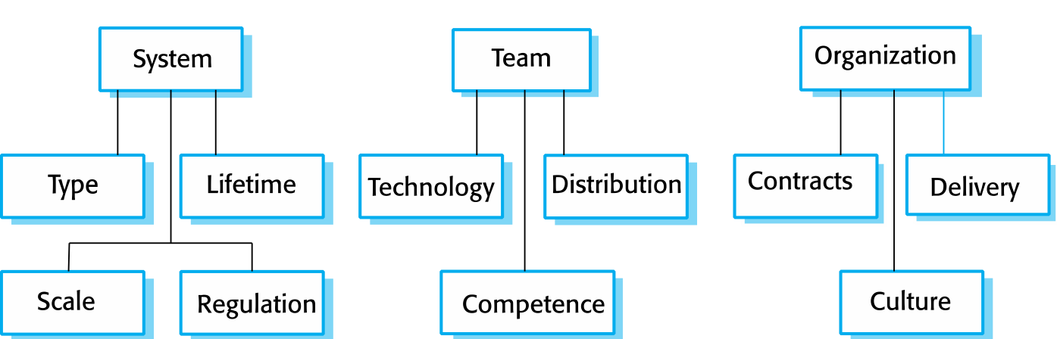
Agile and plan-based factors
Chapter 3 Agile Software Development

Slide 63
System issues
How large is the system being developed?
Agile methods are most effective a relatively small co-located team who can communicate informally
What type of system is being developed?
Systems that require a lot of analysis before implementation need a fairly detailed design to carry out this analysis
What is the expected system lifetime?
Long-lifetime systems require documentation to communicate the intentions of the system developers to the support team
Is the system subject to external regulation?
If a system is regulated you will probably be required to produce detailed documentation as part of the system safety case
Chapter 3 Agile Software Development

Slide 64
People and teams
How good are the designers and programmers in the development team?
It is sometimes argued that agile methods require higher skill levels than plan-based approaches in which programmers simply translate a detailed design into code.
How is the development team organized?
Design documents may be required if the team is distributed
What support technologies are available?
IDE support for visualization and program analysis is essential if design documentation is not available
Chapter 3 Agile Software Development

Slide 65
Organizational issues
Traditional engineering organizations have a culture of plan-based development, as this is the norm in engineering
Is it standard organizational practice to develop a detailed system specification?
Will customer representatives be available to provide feedback of system increments?
Can informal agile development fit into the organizational culture of detailed documentation?
30/10/2014
Chapter 3 Agile Software Development

Slide 66
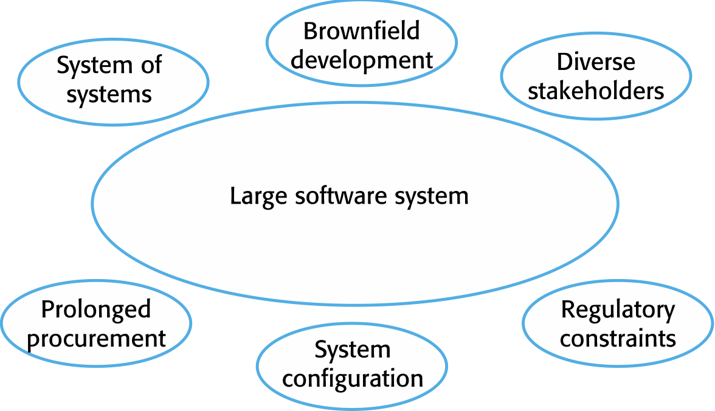
Factors in large systems
Chapter 3 Agile Software Development

Slide 67
Agile methods for large systems
Large systems are usually collections of separate, communicating systems, where separate teams develop each system. Frequently, these teams are working in different places, sometimes in different time zones.
Large systems are ‘brownfield systems’, that is they include and interact with a number of existing systems. Many of the system requirements are concerned with this interaction and so they do not really lend themselves to flexibility and incremental development.
Where several systems are integrated to create a system, a significant fraction of the development is concerned with system configuration rather than original code development.
Chapter 3 Agile Software Development

Slide 68
Large system development
Large systems and their development processes are often constrained by external rules and regulations limiting the way that they can be developed.
Large systems have a long procurement and development time. It is difficult to maintain coherent teams who know about the system over that period as, inevitably, people move on to other jobs and projects.
Large systems usually have a diverse set of stakeholders. It is practically impossible to involve all of these different stakeholders in the development process.
Chapter 3 Agile Software Development

Slide 69
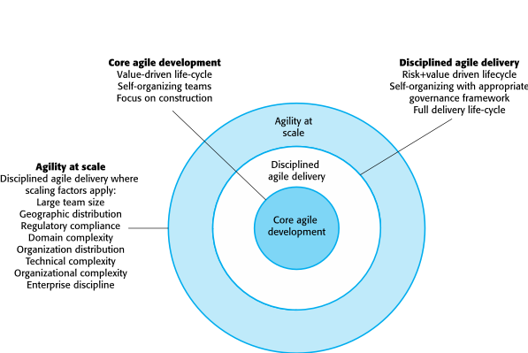
IBM’s agility at scale model
Chapter 3 Agile Software Development

Slide 70
Scaling up to large systems
A completely incremental approach to requirements engineering is impossible
There cannot be a single product owner or customer representative
For large systems development, it is not possible to focus only on the code of the system
Cross-team communication mechanisms have to be designed and used
Continuous integration is practically impossible. However, it is essential to maintain frequent system builds and regular releases of the system.
Chapter 3 Agile Software Development

Slide 71
Multi-team Scrum
Role replication
Each team has a Product Owner for their work component and a ScrumMaster
Product architects
Each team chooses a product architect and these architects collaborate to design and evolve the overall system architecture
Release alignment
The dates of product releases from each team are aligned so that a demonstrable and complete system is produced
Scrum of Scrums
There is a daily Scrum of Scrums where representatives from each team meet to discuss progress and plan work to be done
Chapter 3 Agile Software Development

Slide 72
Agile methods across organizations
Project managers who do not have experience of agile methods may be reluctant to accept the risk of a new approach
Large organizations often have quality procedures and standards that all projects are expected to follow and, because of their bureaucratic nature, these are likely to be incompatible with agile methods
Agile methods seem to work best when team members have a relatively high skill level. However, within large organizations, there are likely to be a wide range of skills and abilities.
There may be cultural resistance to agile methods, especially in those organizations that have a long history of using conventional systems engineering processes
Chapter 3 Agile Software Development

Slide 73
Key points
Agile methods are incremental development methods that focus on rapid software development, frequent releases of the software, reducing process overheads by minimizing documentation and producing high-quality code
Agile development practices include:
User stories for system specification
Frequent releases of the software
Continuous software improvement
Test-first development
Customer participation in the development team
Chapter 3 Agile Software Development

Slide 74
Key points
Scrum is an agile method that provides a project management framework
It is centred round a set of sprints, which are fixed time periods when a system increment is developed
Many practical development methods are a mixture of plan-based and agile development
Scaling agile methods for large systems is difficult
Large systems need up-front design and some documentation and organizational practice may conflict with the informality of agile approaches
Chapter 3 Agile Software Development

Slide 75
Professional Tip of the Day
How to ask for a raise or promotion?
Understand your leveling or promotion system
Contact HR for the job description or details
Ensure you meet the requirements and qualifications for the promotion
Document how you qualify for the promotion
Ask for projects that expand your development skills
Approach your boss or manager
Look for a new job
Chapter 4 Requirements Engineering

